Slide 1

CSE- AI & ML
Unit-5
Coding and Unit Testing
Kedar Pinniboyina
Assistant Professor
AI&ML Department

Slide 2
Programming Principles and Guidelines
Programming principles are basic rules that help developers write correct, readable, and maintainable code.
Key Principles
a) Correctness
The program must produce correct output for all valid inputs.
Example: A calculator must give correct results for all arithmetic operations.
b) Simplicity (KISS – Keep It Simple, Stupid)
Code should be easy to understand.
Avoid unnecessary logic and over-engineering.

Slide 3
Programming Principles and Guidelines
c) Modularity
Divide the program into small independent modules/functions.
Each module performs one specific task.
d) Reusability
Code should be reusable in other programs.
Example: A sorting function used in multiple projects.
e) Maintainability
Code should be easy to modify and update.
Achieved using comments, proper naming, and structure.

Slide 4
Programming Practices
Programming practices are techniques followed while coding to improve software quality.
Good Programming Practices
Use meaningful variable and function names
Write comments to explain complex logic
Follow indentation and formatting
Avoid hard-coding values (use constants)
Handle errors and exceptions properly

Slide 5
Programming Practices (Contd.)
Control construct
The single entry and exit constructs need to be used.
Use of go to
The go to statements make the program unstructured. So avoid the use of goto statements as possible.
User-defined data types
User can define data type to enhance the readability of the code.
Information hiding

Slide 6
Programming Practices (Contd.)
# Bad practice
x = a * b
# Good practice
area = length * width

Slide 7
Coding Standards
Coding standards are rules and conventions for writing code in a uniform style.
Purpose of Coding Standards
Improves readability
Makes teamwork easier
Reduces errors
Helps in maintenance
Common Coding Standards
Naming conventions (camelCase, snake_case)
Proper indentation
Line length limitations
Commenting standards
File and class organization

Slide 8
Incremental Development of Code
Incremental development means building software step by step, instead of writing the entire code at once.
Steps
Write a small part of the code
Test it
Improve it
Add new functionality

Slide 9
Incremental Development of Code
Advantages
Easy debugging
Early error detection
Better quality software
Example
Step 1: Create login form
Step 2: Validate username
Step 3: Add password authentication
Step 4: Connect to database

Slide 10
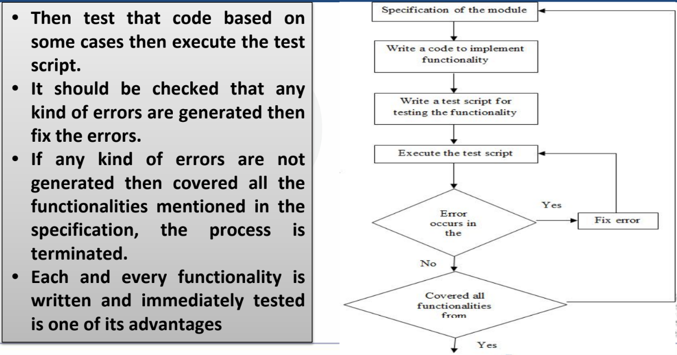
Incremental Development of Code

Slide 11
Verification vs Validation
Verification
Are we building the product right?
Checks whether software is built according to requirements and design
No code execution
Done using reviews, inspections, and walkthroughs
Validation
Are we building the right product?
Checks whether software meets user needs
Code is executed
Done using testing (Unit, System, Acceptance)

Slide 12
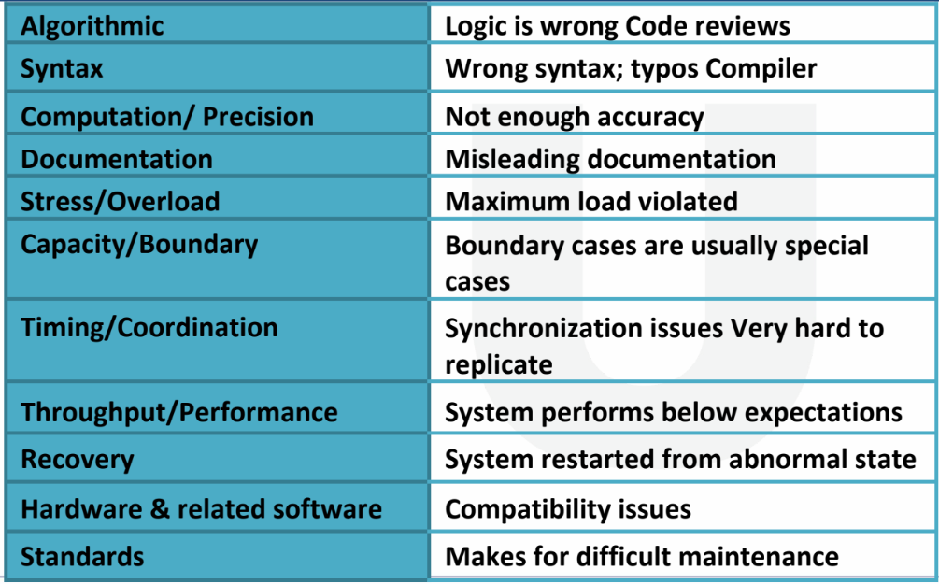
The Types of Faults

Slide 13
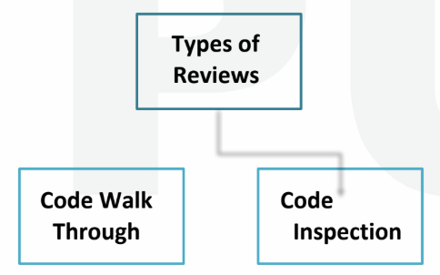
Code Review
CodeReview is carried out after the module is successfully compiled and all the syntax errors have been eliminated.

Slide 14
Code Walkthrough
Code Walkthrough is a static review technique in which the author of the code explains the program logic step-by-step to a group of reviewers.
Key Points:
Code is not executed
Developer explains the code
Focus is on understanding and logic
Purpose:
Find logical errors early
Improve code clarity
Share knowledge among team members

Slide 15
Code Walkthrough – Example
Sample code:
def divide(a, b):
return a / b
Walkthrough Discussion:
Author explains how division works
Reviewers ask: What happens if b = 0?
Logical error identified (division by zero)
Now we need to improve the code

Slide 16
Code Inspection
Code Inspection is a formal and systematic technique used to check source code without executing it in order to detect defects, logical errors, and standard violations.
Key Points:
Static verification technique
More formal than walkthrough
Uses predefined roles and checklists
Focuses on defect detection
Objective:
Find errors early
Improve software quality
Reduce cost of later fixes

Slide 17
Software Documentation
When various kinds of software products are developed, various kinds of
documents are also developed as part of any software engineering process
e.g.
• Users’ manual,
• Software requirements specification (SRS) documents,
• Design documents,
• Test documents,
• Installation manual, etc

Slide 18
Few Classical Programming Errors
▪ Jumps into loops
▪ Non-terminating loops
▪ Array indices out of bounds
▪ Improper storage allocation and de-allocation
▪ Mismatches between actual and formal parameters in procedure calls
▪ Use of incorrect logical operators or incorrect precedence among operators
▪ Improper modification of loop variables

Slide 19
Software Testing
Software Testing is the process of checking a software application to ensure it works correctly and meets user requirements.
Key Points:
Helps identify bugs and defects
Ensures software meets requirements
Improves quality and reliability

Slide 20
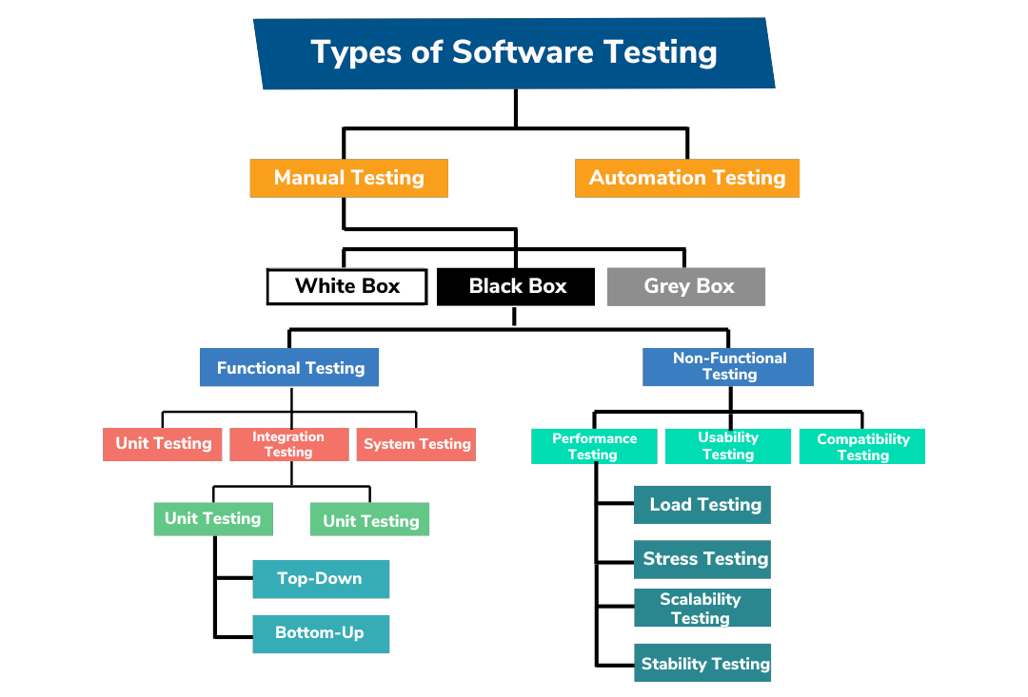

Slide 21
When to test Software?
Software testing should be done throughout the SDLC(software development life cycle), not only at the end.
Testing is done at different stages:
Unit Testing – after coding each module
Integration Testing – after combining modules
System Testing – after completing the full system
Acceptance Testing – before delivery to the customer
Installation Testing – after installing in user environment
Key Point:
Test early and test continuously to detect errors as soon as possible and reduce cost.

Slide 22
Unit Testing Strategy
Unit Testing means testing individual units/modules of code (like functions, methods, or classes) to ensure they work correctly.

Slide 23
Unit Testing Strategy
Stubs and Drivers help test a module independently without waiting for other modules to be developed.
Driver
A dummy main program
Sends test data to the module under test
Used in Bottom-Up Testing
Stub
A dummy called module
Returns fixed / dummy output
Used in Top-Down Testing

Slide 24
Unit Testing Strategy
Real-Time Example
Application has Module A, Module B, Module C
Module B depends on A and C
Only Module B is developed
Solution
Replace Module A with Driver
Replace Module C with Stub
This allows complete testing of Module B in isolation
Diagram
Driver (fake A)
↓
Module B ←── Stub (fake C)

Slide 25
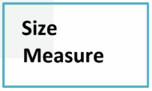
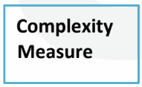
Metrics
Metrics are quantitative measurements used to evaluate the software, process, or project.
Types of Measures

Slide 26
Size Measure
Size Measure is a software metric used to measure the size of a software product in terms of code or functionality. It helps in estimating effort, cost, and development time.
➤ Types of Size Measures
🔹 LOC (Lines of Code) 🔹 Function Points (FP)
🔹 Effort = Person month 🔹 Cost = $/KLOC

Slide 27
Complexity Measure
A complexity measure is a metric used to determine how much complex a software program is, based on its structure, logic, and control flow.
Complexity can be done by various methods, such as
Cyclomatic complexity
Halstead measure
Knot count measure.

Slide 28
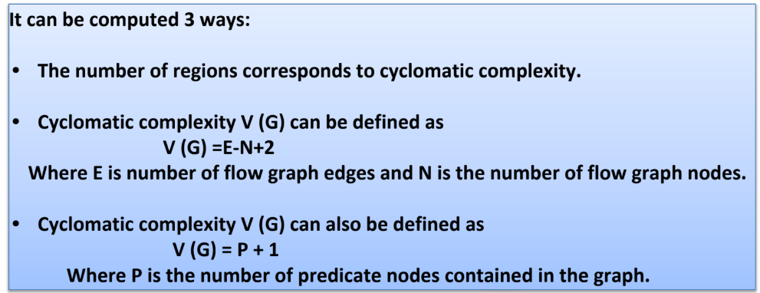
Cyclomatic complexity
Cyclomatic Complexity is a software metric used to measure the logical complexity of a program. It indicates the number of independent paths in the code.

Slide 29
Cyclomatic complexity
Given Pseudocode
IF A = 354
THEN IF B > C
THEN A = B
ELSE A = C
ENDIF
ENDIF
Print A

Slide 30
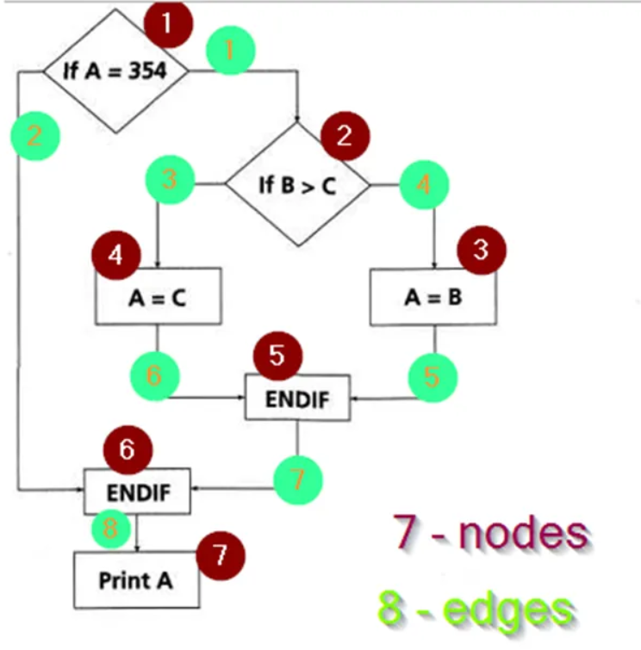
Cyclomatic complexity

Slide 31
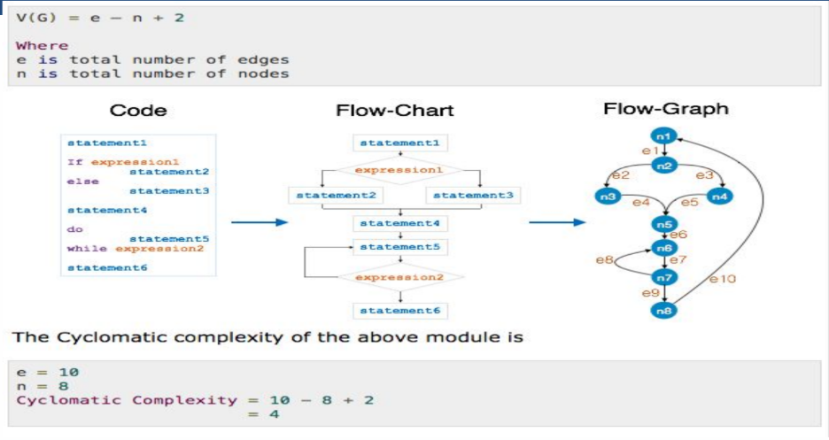
Cyclomatic complexity

Slide 32
Halstead Measure
Halstead Measure is a software complexity metric. It measures program complexity based on operators and operands used in the code.
Basic Terms
Symbol | Meaning
n₁ | Number of distinct operators
n₂ | Number of distinct operands
N₁ | Total occurrences of operators
N₂ | Total occurrences of operands

Slide 33
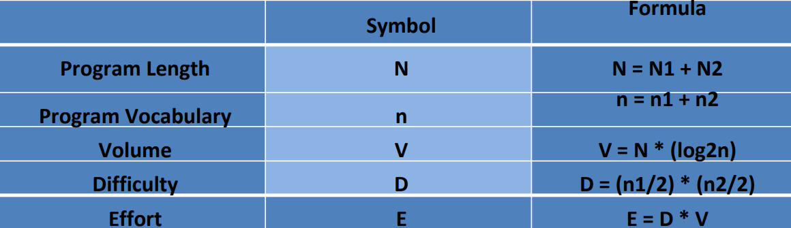
Halstead Measure Formulas

Slide 34
Steps to Calculate Halstead Measure
Step 1: Identify Distinct Operators and Operands
Step 2: Count Total Operators and Operands
Step 3: Apply Halstead Formulas

Slide 35
Halstead Measure Example
int a = 10;
int b = 20;
int c = a + b;
Step 1: Identify Operators and Operands Operators (symbols / keywords that perform actions) int = + Distinct operators (n₁) = 3

Slide 36
Halstead Measure Example
Operands (variables / constants)
a
b
c
10
20
Distinct operands (n₂) = 5

Slide 37
Halstead Measure Example
Step 2: Count Total Operators and Operands
Total operators (N₁)
int → 3 times
= → 3 times
+ → 1 time
N₁ = 7
Total operands (N₂)
a → 2 times
b → 2 times
c → 1 time
10 → 1 time
20 → 1 time
N₂ = 7

Slide 38
Halstead Measure Example
Step 3: Apply Halstead Formulas
1️⃣ Program Vocabulary (n)
n = n₁ + n₂ = 3 + 5 = 8
2️⃣ Program Length (N)
N = N₁ + N₂ = 7 + 7 = 14
3️⃣ Program Volume (V)
V = N × log₂(n)
V = 14 × log₂(8)
V = 14 × 3
V = 42

Slide 39
Halstead Measure Example
4️⃣ Difficulty (D)
D = (n₁ / 2) × (N₂ / n₂)
D = (3 / 2) × (7 / 5)
D = 1.5 × 1.4
D = 2.1
5️⃣ Effort (E)
E = D × V
E = 2.1 × 42
E = 88.2

Slide 40
Halstead Measure Example
a = b + c;
Operators: =, + → n₁ = 2, N₁ = 2 Operands: a, b, c → n₂ = 3, N₂ = 3
Calculate:
N = 2 + 3 = 5
n = 2 + 3 = 5
V = 5 × log₂(5)

Slide 41
Knot Count
Knot Count is a software complexity measure used in Software Engineering, especially while analyzing control flow of a program.
It is basically designed for FORTRAN programs.
More number of knots indicates more complex in the program.

Slide 42
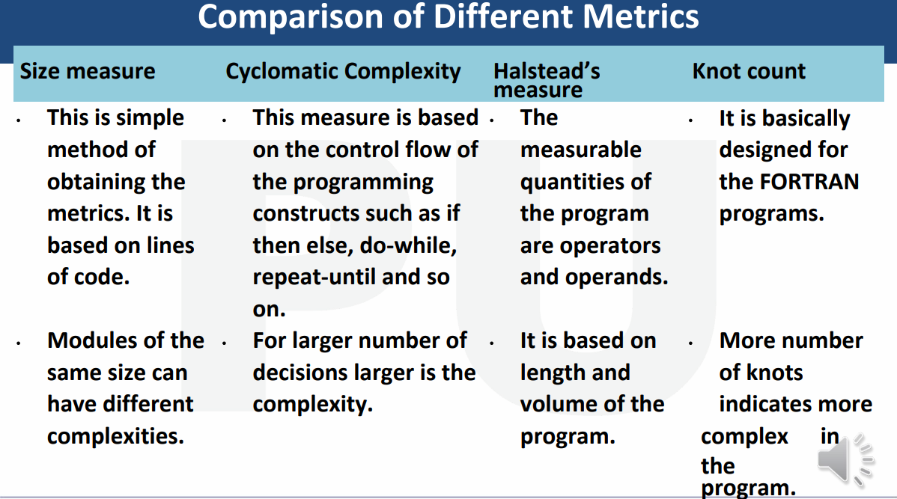
Knot Count

Slide 43


www.paruluniversity.ac.in

